Slide 1
Machine learning: Methods and Tools
Wolfgang Ecker, Elena Zennaro, Lorenzo Servadei

Slide 2
Recurrent Neural Networks

Slide 3

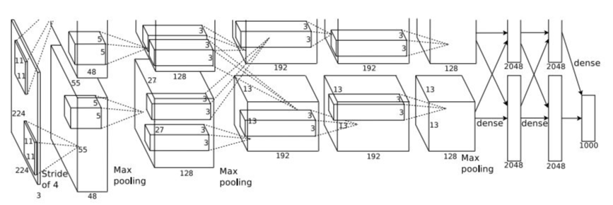


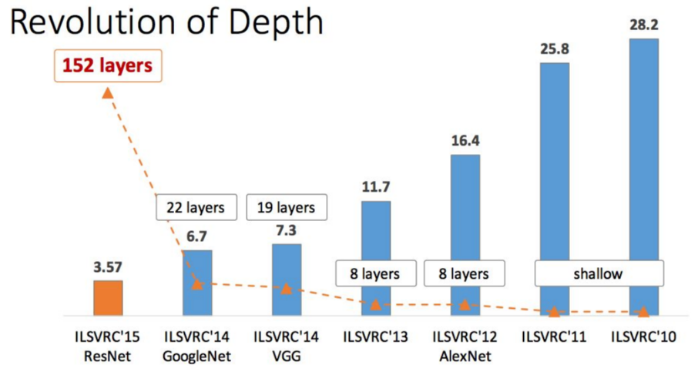


CNN Architectures
AlexNet
Figure copyright Kaiming He, 2016. Reproduced with permission.

Slide 4

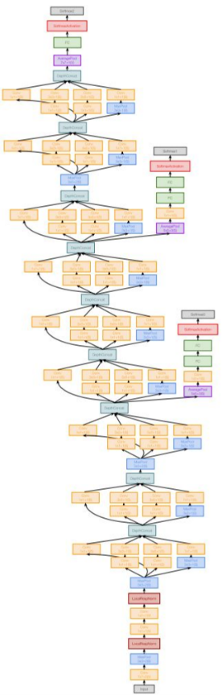





CNN Architectures
Softmax
FC 1000
Softmax
FC 4096
FC 1000
FC 4096
FC 4096
Pool
FC 4096
3x3 conv, 512
Pool
3x3 conv, 512
3x3 conv, 512
3x3 conv, 512
3x3 conv, 512
3x3 conv, 512
3x3 conv, 512
Pool
Pool
3x3 conv, 512
3x3 conv, 512
3x3 conv, 512
3x3 conv, 512
3x3 conv, 512
3x3 conv, 512
3x3 conv, 512
Pool
Pool
3x3 conv, 256
3x3 conv, 256
3x3 conv, 256
3x3 conv, 256
Pool
Pool
3x3 conv, 128
3x3 conv, 128
3x3 conv, 128
3x3 conv, 128
Pool
Pool
3x3 conv, 64
3x3 conv, 64
3x3 conv, 64
3x3 conv, 64
Input
Input
VGG16
VGG19
GoogLeNet
Figure copyright Kaiming He, 2016. Reproduced with permission.

Slide 5





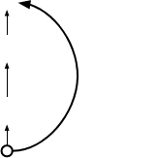
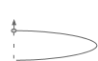














CNN Architectures
Softmax
FC 1000
Pool
3x3 conv, 64
3x3 conv, 64
relu
3x3 conv, 64
3x3 conv, 64
F(x) + x
3x3 conv, 64
3x3 conv, 64
...
conv
3x3 conv, 128
F(x)
relu
X
3x3 conv, 128
identity
3x3 conv, 128
conv
3x3 conv, 128
3x3 conv, 128
3x3 conv, 128 / 2
3x3 conv, 64
X
3x3 conv, 64
Residual block
3x3 conv, 64
3x3 conv, 64
3x3 conv, 64
3x3 conv, 64
Pool
7x7 conv, 64 / 2
Figure copyright Kaiming He, 2016. Reproduced with permission.
Input

Slide 6



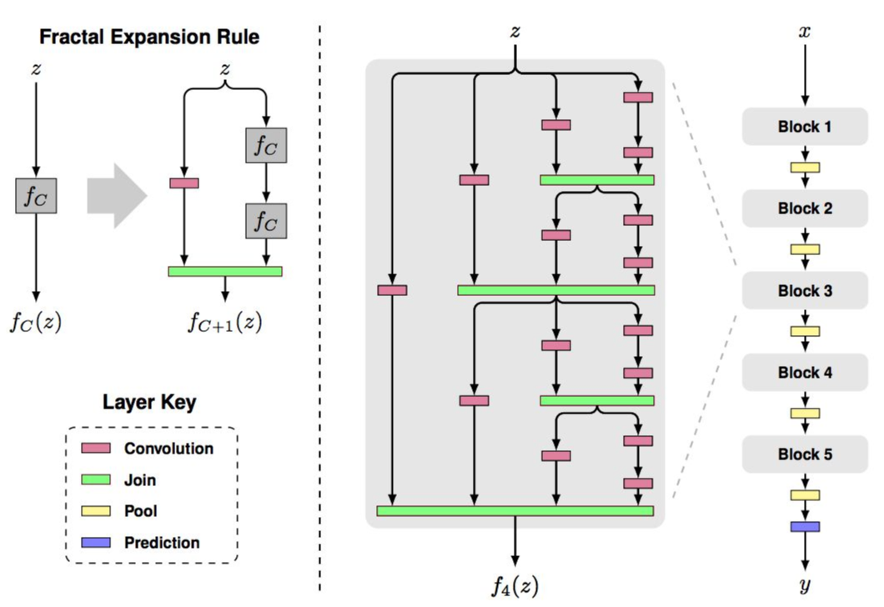
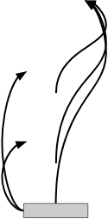

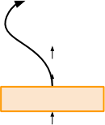


CNN Architectures
DenseNet
FractalNet
Softmax
FC
1x1 conv, 64
Pool
Concat
Dense Block 3
Conv
1x1 conv, 64
Pool
Conv
Concat
Dense Block 2
Conv
Conv
Pool
Concat
Conv
Dense Block 1
Conv
Conv
Input
Input
Dense Block
Figures copyright Larsson et al., 2017. Reproduced with permission.

Slide 7
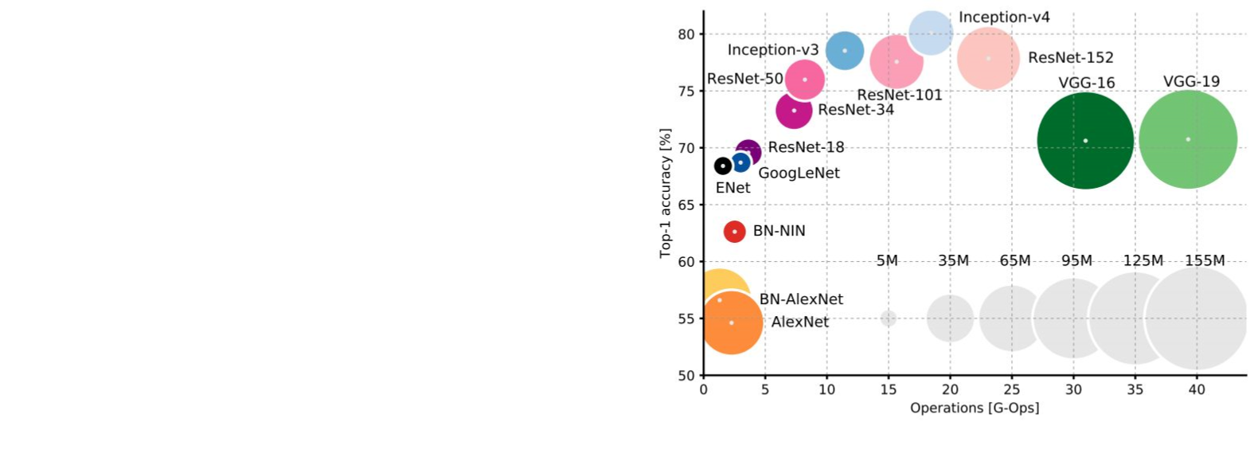
CNN Architectures

Slide 8

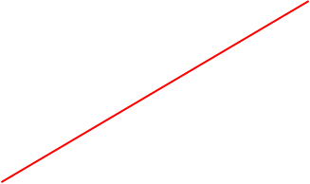


CNN Architectures
AlexNet and VGG have
tons of parameters in the
fully connected layers
AlexNet: ~62M parameters
FC6: 256x6x6 -> 4096: 38M params
FC7: 4096 -> 4096: 17M params
FC8: 4096 -> 1000: 4M params
~59M params in FC layers!

Slide 9
Recurrent Neural Networks

Slide 10
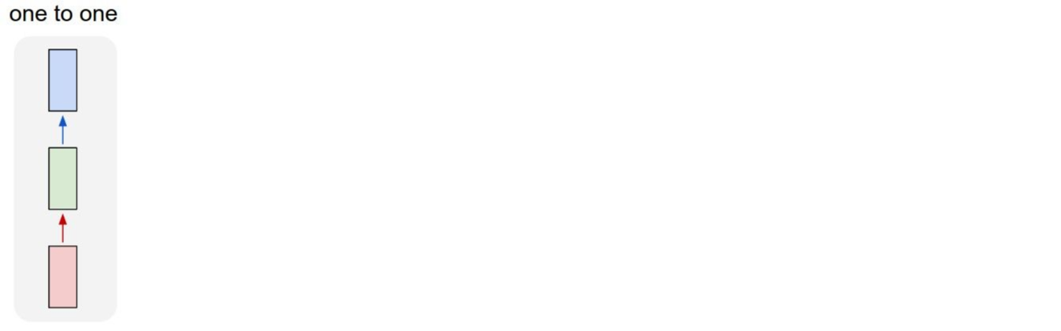



“Vanilla” Neural Network
10
Vanilla Neural Networks

Slide 11

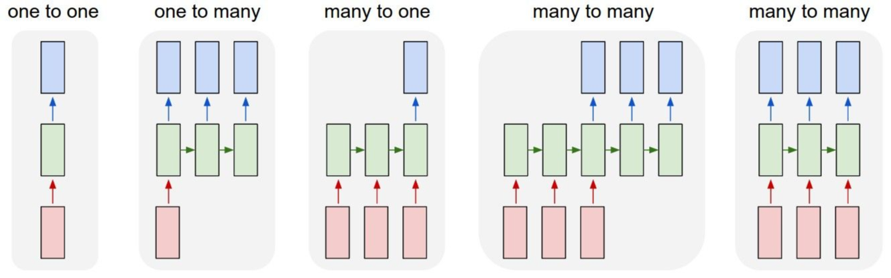



Recurrent Neural Networks: Process Sequences
e.g. Image Captioning
image -> sequence of words

Slide 12



Recurrent Neural Networks: Process Sequences
e.g. Sentiment Classification
sequence of words -> sentiment

Slide 13

Recurrent Neural Networks: Process Sequences
e.g. Machine Translation
seq of words -> seq of words

Slide 14

Recurrent Neural Networks: Process Sequences
e.g. Video classification on frame level

Slide 15
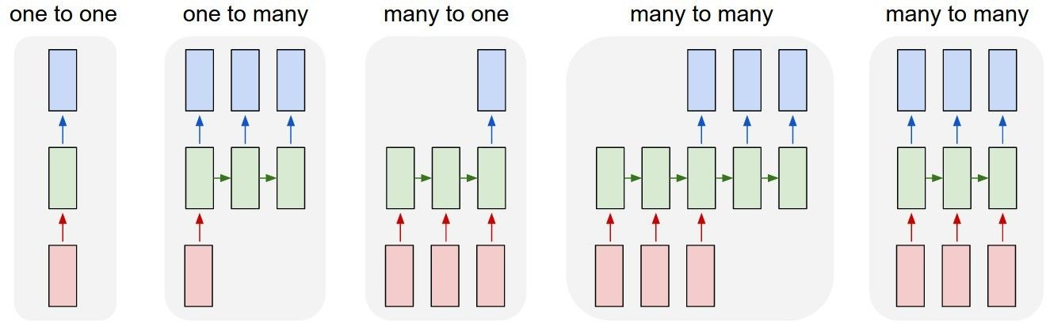
Recurrent Neural Networks: Process Sequences
e.g. Machine Translation
seq of words -> seq of words
15

Slide 16

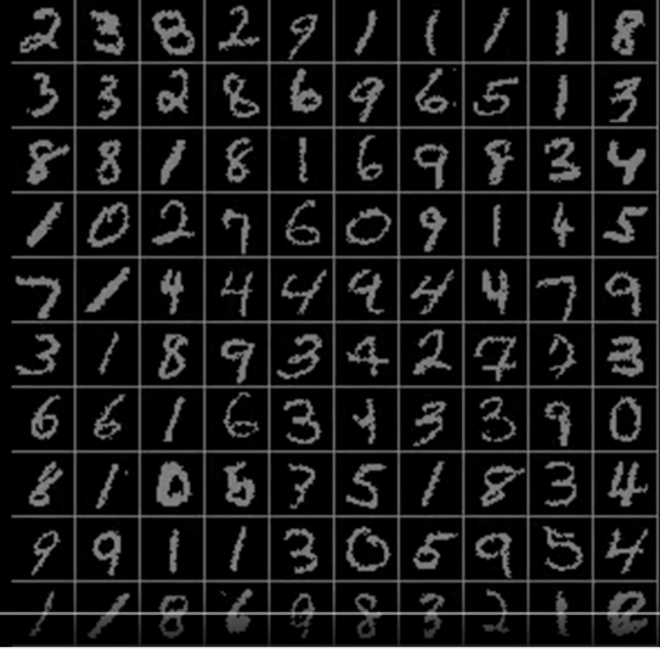

Sequential Processing of Non-Sequence Data
Classify images by taking a
series of “glimpses”
Ba, Mnih, and Kavukcuoglu, “Multiple Object Recognition with Visual Attention”, ICLR 2015.
Gregor et al, “DRAW: A Recurrent Neural Network For Image Generation”, ICML 2015
Figure copyright Karol Gregor, Ivo Danihelka, Alex Graves, Danilo Jimenez Rezende, and Daan Wierstra, 2015. Reproduced with
permission.

Slide 17

Sequential Processing of Non-Sequence Data

Slide 18
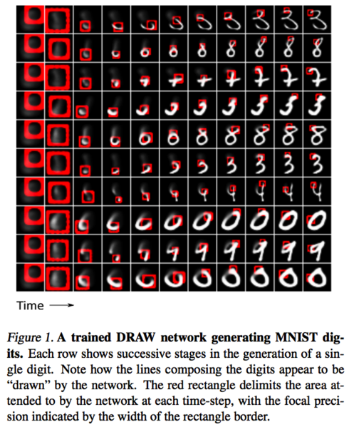

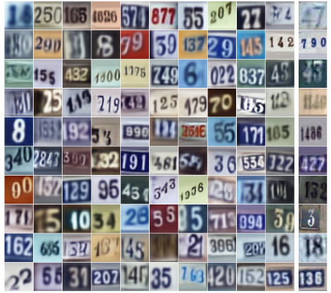
Sequential Processing of Non-Sequence Data
Generate images one piece at a time!
Gregor et al, “DRAW: A Recurrent Neural Network For Image Generation”, ICML 2015
Figure copyright Karol Gregor, Ivo Danihelka, Alex Graves, Danilo Jimenez Rezende, and Daan Wierstra, 2015. Reproduced with
permission.

Slide 19






Recurrent Neural Network
RNN
x

Slide 20





Recurrent Neural Network
usually want to
y
predict a vector at
some time steps
RNN
x

Slide 21







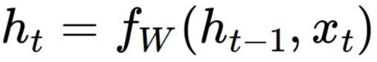











Recurrent Neural Network
We can process a sequence of vectors x by
applying a recurrence formula at every time step:
y
RNN
new state
old state
input vector at
some time step
some function
x
with parameters W

Slide 22
Recurrent Neural Network
We can process a sequence of vectors x by
applying a recurrence formula at every time step:
y
RNN
Notice: the same function and the same set
x
of parameters are used at every time step.

Slide 23








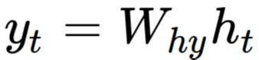
(Vanilla) Recurrent Neural Network
The state consists of a single “hidden” vector h:
y
RNN
x

Slide 24








RNN: Computational Graph
h
f
h
W
0
1
x
1

Slide 25






RNN: Computational Graph
h
f
h
f
h
W
W
0
1
2
x
x
1
2

Slide 26






RNN: Computational Graph
…
h
f
h
f
h
f
h
h
W
W
W
0
1
2
3
T
x
x
x
1
2
3

Slide 27



RNN: Computational Graph
Re-use the same weight matrix at every time-step
…
h
f
h
f
h
f
h
h
W
W
W
0
1
2
3
T
x
x
x
W
1
2
3

Slide 28







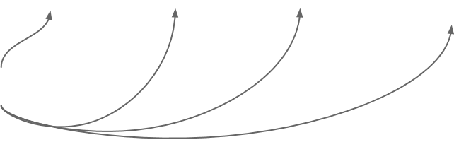
RNN: Computational Graph: Many to Many
y
y
y
y
1
2
3
T
…
h
f
h
f
h
f
h
h
0
W
1
W
2
W
3
T
x
x
x
W
1
2
3

Slide 29







RNN: Computational Graph: Many to Many
y
L
y
L
y
L
y
L
1
1
2
2
3
3
T
T
…
h
f
h
f
h
f
h
h
0
W
1
W
2
W
3
T
x
x
x
W
1
2
3

Slide 30


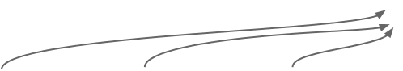


RNN: Computational Graph: Many to Many
L
y
L
y
L
y
L
y
L
1
1
2
2
3
3
T
T
…
h
f
h
f
h
f
h
h
0
W
1
W
2
W
3
T
x
x
x
W
1
2
3

Slide 31
RNN: Computational Graph: Many to One
y
…
h
f
h
f
h
f
h
h
0
W
1
W
2
W
3
T
x
x
x
W
1
2
3

Slide 32
RNN: Computational Graph: One to Many
y
y
y
y
3
3
3
T
…
h
f
h
f
h
f
h
h
0
W
1
W
2
W
3
T
x
W

Slide 33








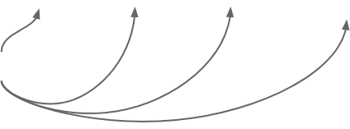


Seq to Seq: Many-to-one +
one-to-many
Many to one: Encode input
sequence in a single vector
h
f
h
f
h
f
h
…
h
0
W
1
W
2
W
3
T
x
x
x
W
1
2
3
1

Slide 34






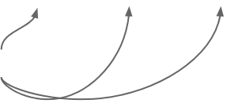

Seq to Seq: Many-to-one +
one-to-many
One to many: Produce output
sequence from single input vector
Many to one: Encode input
sequence in a single vector
y
y
1
2
h
f
h
f
h
f
h
…
h
h
h
…
W
W
W
f
W
f
W
f
W
0
1
2
3
T
1
2
x
x
x
W
W
1
2
3
1
2

Slide 35
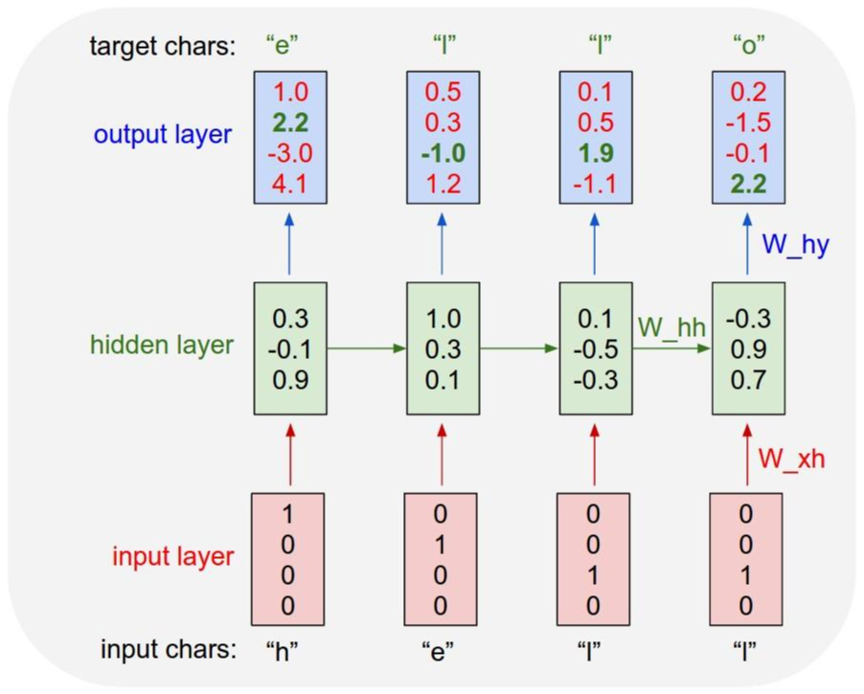

Example:
Character-level
Language Model
Vocabulary:
[h,e,l,o]
Example training
sequence:
“hello”

Slide 36



Example:
Character-level
Language Model
Vocabulary:
[h,e,l,o]
Example training
sequence:
“hello”

Slide 37
Example:
Character-level
Language Model
Vocabulary:
[h,e,l,o]
Example training
sequence:
“hello”

Slide 38














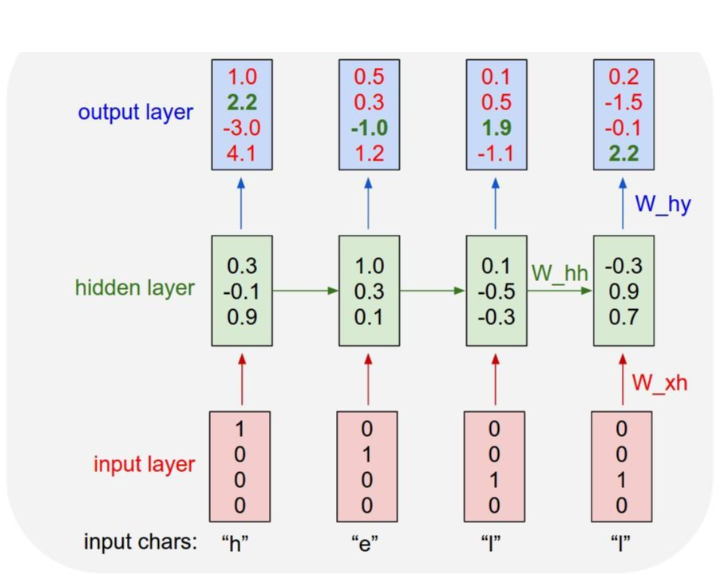

Example:
“e”
“l”
“l”
“o”
Sample
Character-level
.03
.25
.11
.11
Language Model
Softmax
.13
.20
.17
.02
.00
.05
.68
.08
.84
.50
.03
.79
Sampling
Vocabulary:
[h,e,l,o]
At test-time sample
characters one at a time,
feed back to model

Slide 39

Example:
“e”
“l”
“l”
“o”
Sample
“l”
“l”
“o”
Character-level
.03
.25
.11
.11
.13
.25
.11
.11
Language Model
Softmax
.20
.17
.02
.00
.20
.17
.02
.05
.68
.08
.84
.05
.68
.08
.50
.03
.79
Sampling
.50
.03
.79
Vocabulary:
[h,e,l,o]
At test-time sample
characters one at a time,
feed back to model

Slide 40
Example:
“e”
“l”
“l”
“o”
Sample
Character-level
.03
.25
.11
.11
Softmax
.13
.20
.17
.02
Language Model
.00
.05
.68
.08
.84
.50
.03
.79
Sampling
Vocabulary:
[h,e,l,o]
At test-time sample
characters one at a time,
feed back to model

Slide 41
Example:
“e”
“l”
“l”
“o”
Sample
Character-level
.03
.25
.11
.11
Softmax
.13
.20
.17
.02
Language Model
.00
.05
.68
.08
.84
.50
.03
.79
Sampling
Vocabulary:
[h,e,l,o]
At test-time sample
characters one at a time,
feed back to model

Slide 42
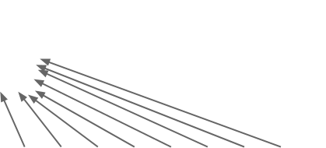


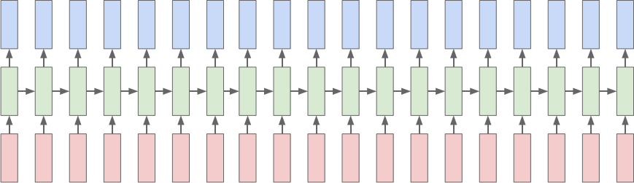
Backpropagation through time
Loss
Forward through entire sequence to
compute loss, then backward through
entire sequence to compute gradient

Slide 43





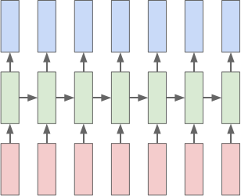
Truncated Backpropagation through time
Loss
Run forward and backward
through chunks of the
sequence instead of whole
sequence

Slide 44
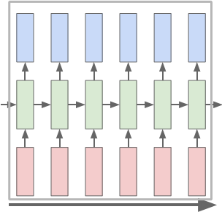

Truncated Backpropagation through time
Loss
Carry hidden states
forward in time forever,
but only backpropagate
for some smaller
number of steps

Slide 45
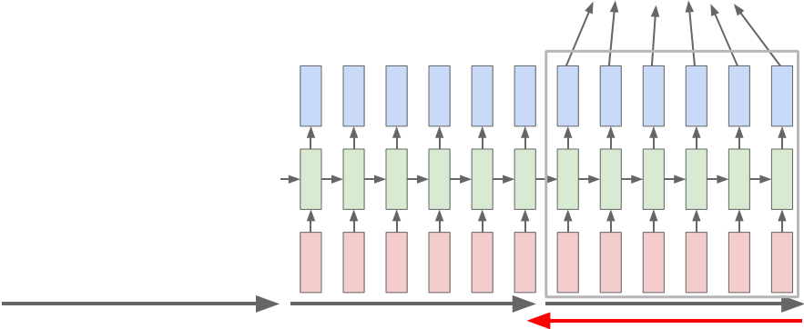
Truncated Backpropagation through time
Loss

Slide 46


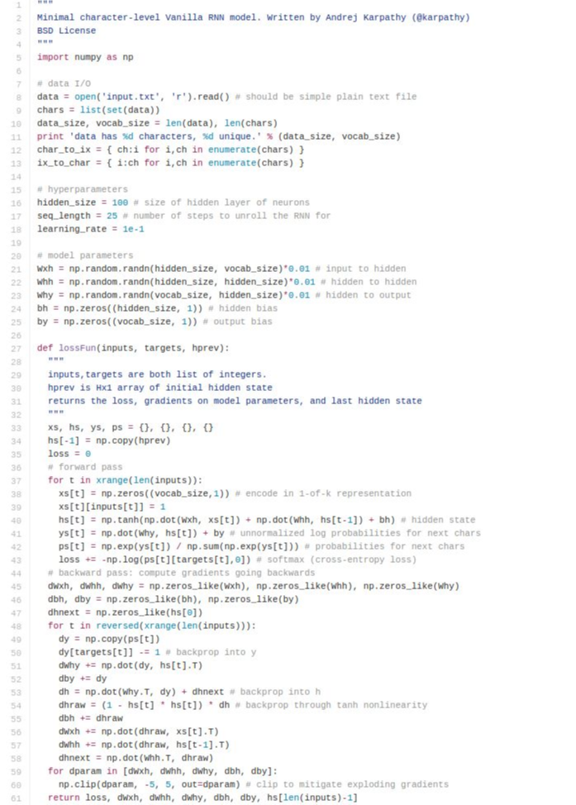
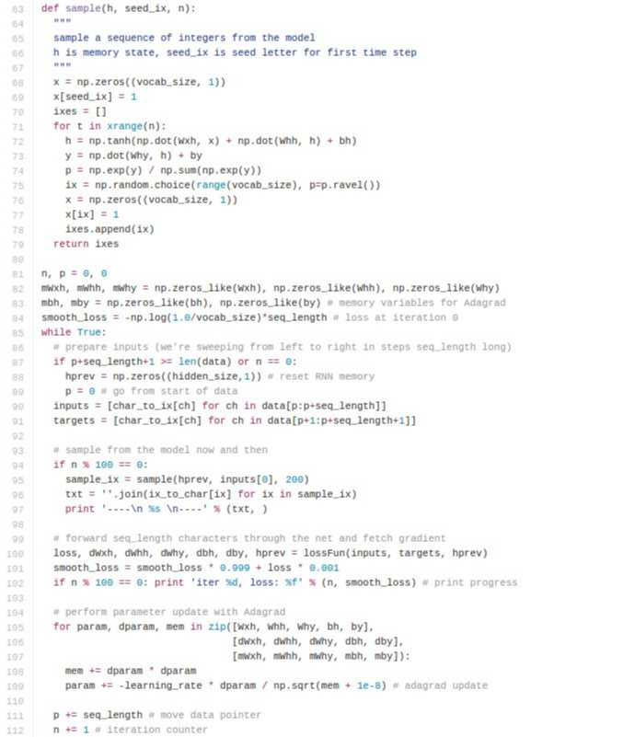
min-char-rnn.py
112 lines of Python
(https://gist.github.com/karpathy/d4dee
566867f8291f086
)

Slide 47
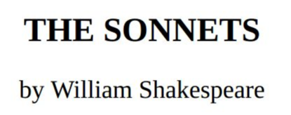




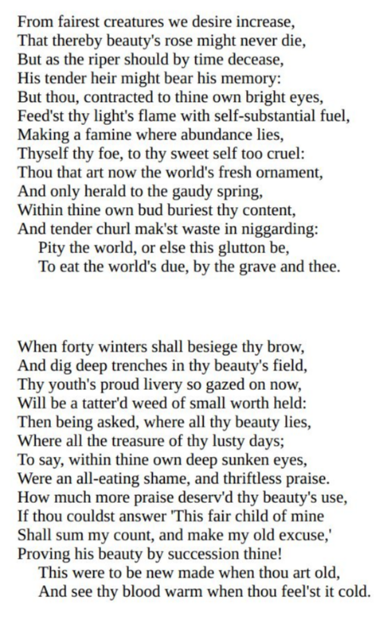




y
RNN
x

Slide 48



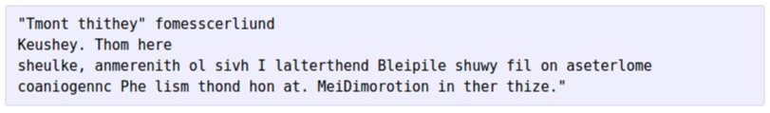


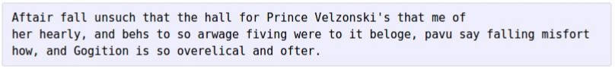

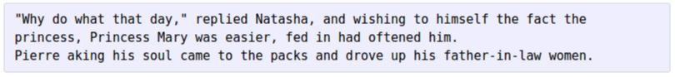
at first:
train more
train more
train more

Slide 49


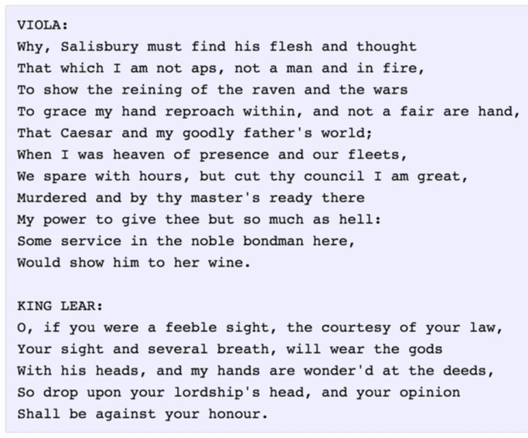
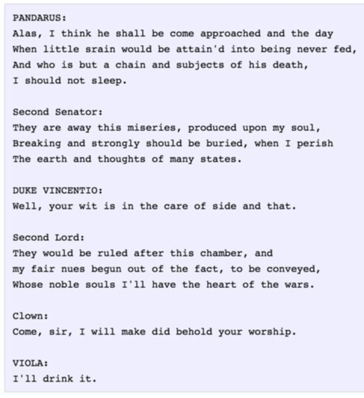

Slide 50


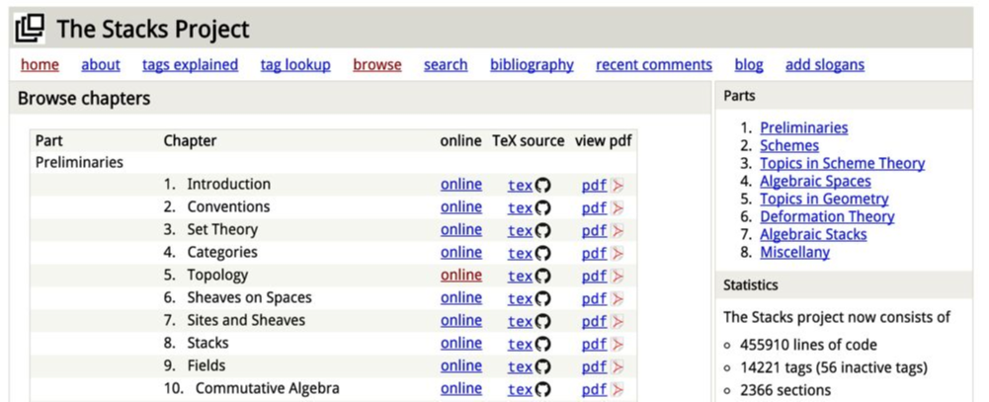




The Stacks Project: open source algebraic geometry textbook
Latex source
http://stacks.math.columbia.edu/
The stacks project is licensed under the GNU Free Documentation License

Slide 51

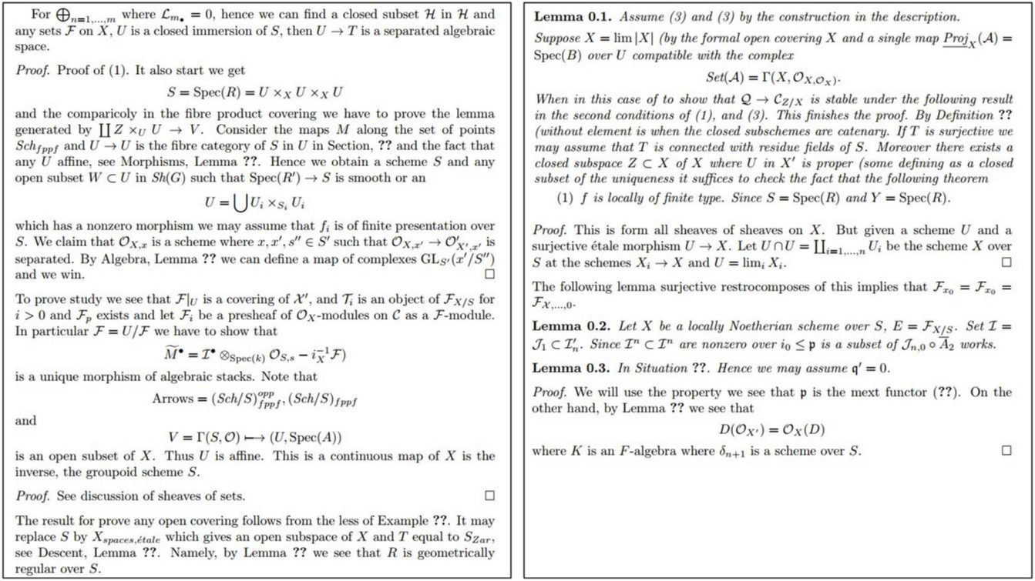

Slide 52

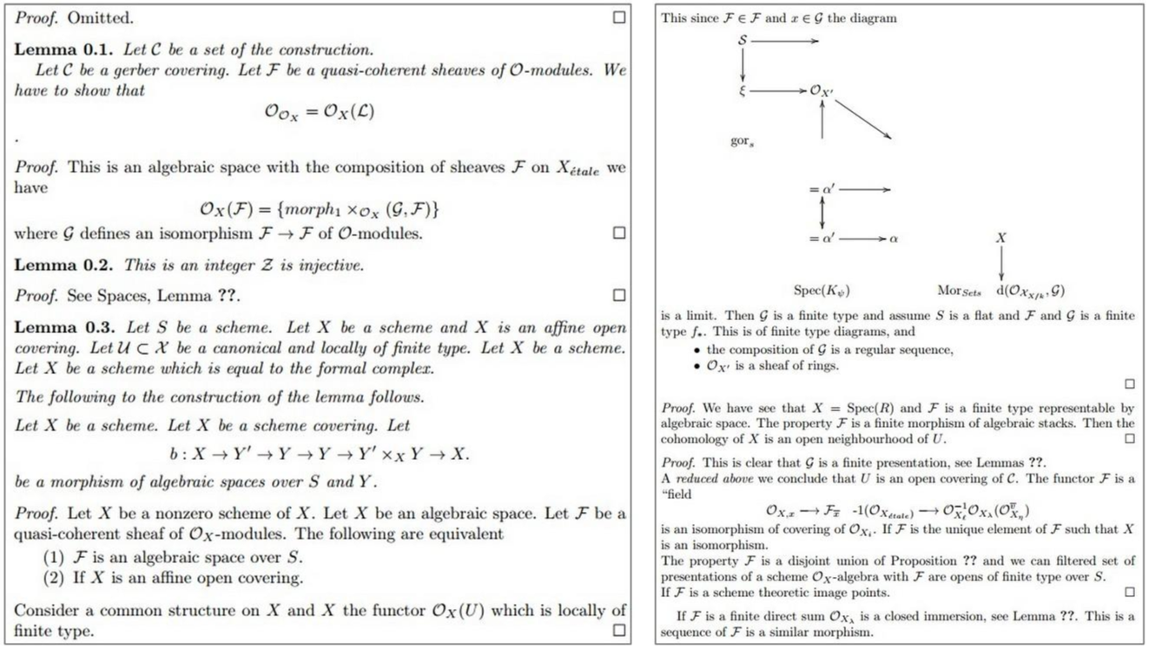

Slide 53
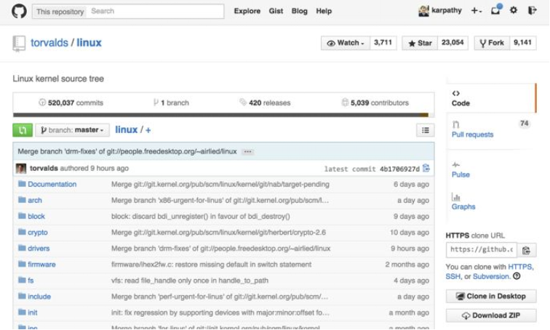


Slide 54

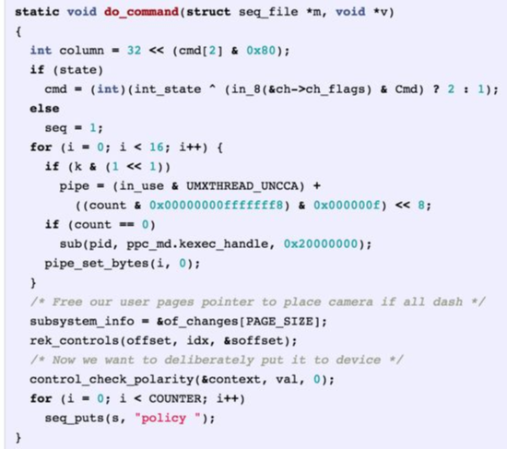

Generated
C code

Slide 55
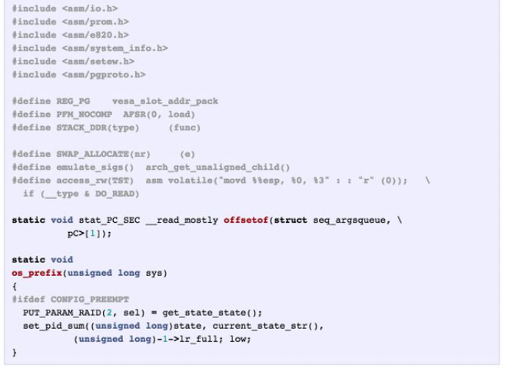

Slide 56
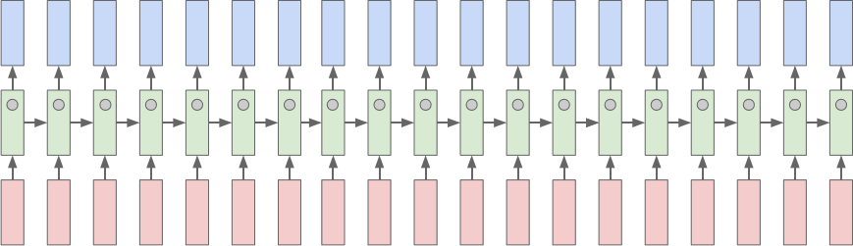
Searching for interpretable cells
Karpathy, Johnson, and Fei-Fei: Visualizing and Understanding Recurrent Networks, ICLR Workshop 2016

Slide 57

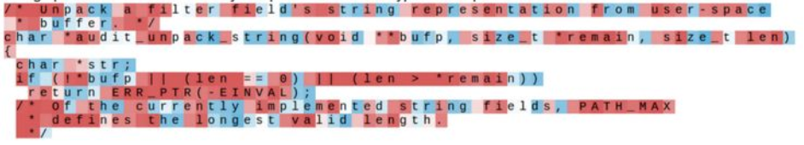
Searching for interpretable cells
Karpathy, Johnson, and Fei-Fei: Visualizing and Understanding Recurrent Networks, ICLR Workshop 2016
Figures copyright Karpathy, Johnson, and Fei-Fei, 2015; reproduced with permission

Slide 58

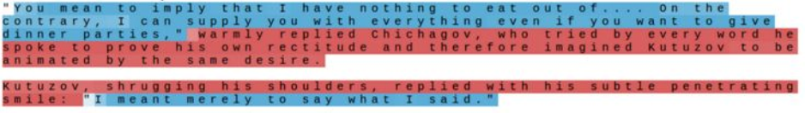

Searching for interpretable cells
quote detection cell
Karpathy, Johnson, and Fei-Fei: Visualizing and Understanding Recurrent Networks, ICLR Workshop 2016

Slide 59

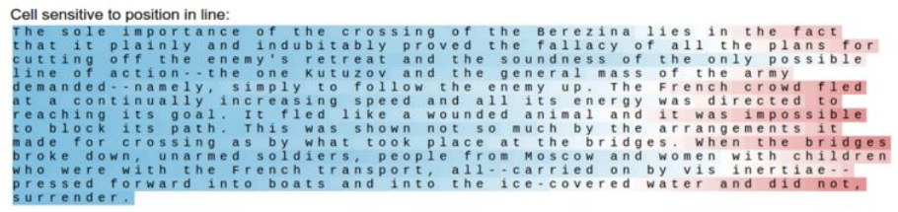
Searching for interpretable cells
line length tracking cell
Karpathy, Johnson, and Fei-Fei: Visualizing and Understanding Recurrent Networks, ICLR Workshop 2016
Figures copyright Karpathy, Johnson, and Fei-Fei, 2015; reproduced with permission

Slide 60

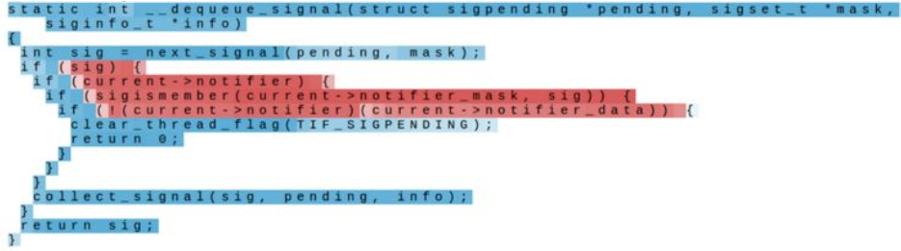
Searching for interpretable cells
if statement cell
Karpathy, Johnson, and Fei-Fei: Visualizing and Understanding Recurrent Networks, ICLR Workshop 2016
Figures copyright Karpathy, Johnson, and Fei-Fei, 2015; reproduced with permission

Slide 61

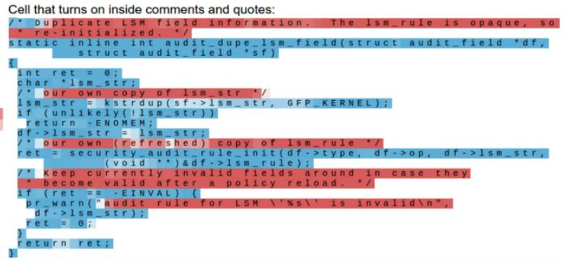

Searching for interpretable cells
quote/comment cell
Karpathy, Johnson, and Fei-Fei: Visualizing and Understanding Recurrent Networks, ICLR Workshop 2016
Figures copyright Karpathy, Johnson, and Fei-Fei, 2015; reproduced with permission

Slide 62



Searching for interpretable cells
code depth cell
Karpathy, Johnson, and Fei-Fei: Visualizing and Understanding Recurrent Networks, ICLR Workshop 2016
Figures copyright Karpathy, Johnson, and Fei-Fei, 2015; reproduced with permission

Slide 63



Image Captioning
Figure from Karpathy et a, “Deep
Visual-Semantic Alignments for Generating
Image Descriptions”, CVPR 2015; figure
Explain Images with Multimodal Recurrent Neural Networks, Mao et al.
copyright IEEE, 2015.
Reproduced for educational purposes.
Deep Visual-Semantic Alignments for Generating Image Descriptions, Karpathy and Fei-Fei
Show and Tell: A Neural Image Caption Generator, Vinyals et al.
Long-term Recurrent Convolutional Networks for Visual Recognition and Description, Donahue et al.
Learning a Recurrent Visual Representation for Image Caption Generation, Chen and Zitnick

Slide 64






Recurrent Neural Network
Convolutional Neural Network

Slide 66




test image
This image
is CC0 public domain

Slide 67


test image

Slide 68


test image
X

Slide 69



test image
x0
<STA
RT>
<START>

Slide 70









test image
y0
before:
h = tanh(Wxh * x + Whh * h)
h0
Wih
now:
h = tanh(Wxh * x + Whh * h + Wih * v)
x0
<STA
RT>
v
<START>

Slide 71





test image
y0
sample!
h0
x0
<STA
straw
RT>
<START>

Slide 72

test image
y0
y1
h0
h1
x0
<STA
straw
RT>
<START>

Slide 73



test image
y0
y1
sample!
h0
h1
x0
<STA
straw
hat
RT>
<START>

Slide 74


test image
y0
y1
y2
h0
h1
h2
x0
<STA
straw
hat
RT>
<START>

Slide 75



test image
y0
y1
y2
sample
<END> token
=> finish.
h0
h1
h2
x0
<STA
straw
hat
RT>
<START>

Slide 76



















Captions generated using neuraltalk2
All images are CC0 Public domain
Image Captioning: Example Results
cat suitcase
, cat tree
, dog
, bear
,
:
surfers
, tennis
, giraffe
, motorcycle
A cat sitting on a
A cat is sitting on a tree
A dog is running in the
A white teddy bear sitting in
suitcase on the floor
branch
grass with a frisbee
the grass
Two people walking on
A tennis player in action
Two giraffes standing in a
A man riding a dirt bike on
the beach with surfboards
on the court
grassy field
a dirt track

Slide 77















Captions generated using neuraltalk2
Image Captioning: Failure Cases
All images are CC0 Public domain
: fur
coat
, handstand
, spider web
, baseball
A bird is perched on
a tree branch
A woman is holding a
cat in her hand
A man in a
baseball uniform
throwing a ball
A woman standing on a
beach holding a surfboard
A person holding a
computer mouse on a desk

Slide 78






Image Captioning with Attention
RNN focuses its attention at a different spatial location
when generating each word
Xu et al, “Show, Attend, and Tell: Neural Image Caption Generation with Visual Attention”, ICML 2015
Figure copyright Kelvin Xu, Jimmy Lei Ba, Jamie Kiros, Kyunghyun Cho, Aaron Courville, Ruslan Salakhutdinov, Richard S. Zemel, and Yoshua Benchio, 2015. Reproduced with permission.
Lecture 10 -
Lecture 10 -
May 4, 2017
Fei-Fei Li & Justin Johnson & Serena Yeung
May 4, 2017
Fei-Fei Li & Justin Johnson & Serena Yeung
77

Slide 79












Image Captioning with Attention
CNN
h0
Features:
Image:
L x D
H x W x 3
Xu et al, “Show, Attend and Tell: Neural
Image Caption Generation with Visual
Attention”, ICML 2015
Lecture 10 -
Lecture 10 -
May 4, 2017
Fei-Fei Li & Justin Johnson & Serena Yeung
May 4, 2017
Fei-Fei Li & Justin Johnson & Serena Yeung
78

Slide 80



Image Captioning with Attention
Distribution over
L locations
a1
CNN
h0
Features:
Image:
L x D
H x W x 3
Xu et al, “Show, Attend and Tell: Neural
Image Caption Generation with Visual
Attention”, ICML 2015
Lecture 10 -
Lecture 10 -
May 4, 2017
Fei-Fei Li & Justin Johnson & Serena Yeung
May 4, 2017
Fei-Fei Li & Justin Johnson & Serena Yeung
79

Slide 81










Image Captioning with Attention
Distribution over
L locations
a1
CNN
h0
Features:
Image:
L x D
H x W x 3
Weighted
features: D
z1
Weighted
Xu et al, “Show, Attend and Tell: Neural
combination
Image Caption Generation with Visual
of features
Attention”, ICML 2015
Lecture 10 -
Lecture 10 -
May 4, 2017
Fei-Fei Li & Justin Johnson & Serena Yeung
May 4, 2017
Fei-Fei Li & Justin Johnson & Serena Yeung
80

Slide 82




Image Captioning with Attention
Distribution over
L locations
a1
CNN
h0
h1
Features:
Image:
L x D
H x W x 3
Weighted
features: D
z1
y1
Weighted
Xu et al, “Show, Attend and Tell: Neural
combination
First word
Image Caption Generation with Visual
of features
Attention”, ICML 2015
Lecture 10 -
Lecture 10 -
May 4, 2017
Fei-Fei Li & Justin Johnson & Serena Yeung
May 4, 2017
Fei-Fei Li & Justin Johnson & Serena Yeung
81

Slide 83




Image Captioning with Attention
Distribution over
Distribution
L locations
over vocab
a1
a2
d1
CNN
h0
h1
Features:
Image:
L x D
H x W x 3
Weighted
features: D
z1
y1
Weighted
Xu et al, “Show, Attend and Tell: Neural
combination
First word
Image Caption Generation with Visual
of features
Attention”, ICML 2015
Lecture 10 -
Lecture 10 -
May 4, 2017
Fei-Fei Li & Justin Johnson & Serena Yeung
May 4, 2017
Fei-Fei Li & Justin Johnson & Serena Yeung
82

Slide 84






Image Captioning with Attention
Distribution over
Distribution
L locations
over vocab
a1
a2
d1
CNN
h0
h1
h2
Features:
Image:
L x D
H x W x 3
Weighted
features: D
z1
y1
z2
y2
Weighted
Xu et al, “Show, Attend and Tell: Neural
combination
First word
Image Caption Generation with Visual
of features
Attention”, ICML 2015
Lecture 10 -
Lecture 10 -
May 4, 2017
Fei-Fei Li & Justin Johnson & Serena Yeung
May 4, 2017
Fei-Fei Li & Justin Johnson & Serena Yeung
83

Slide 85







Image Captioning with Attention
Distribution over
Distribution
L locations
over vocab
a1
a2
d1
a3
d2
CNN
h0
h1
h2
Features:
Image:
L x D
H x W x 3
Weighted
features: D
z1
y1
z2
y2
Weighted
Xu et al, “Show, Attend and Tell: Neural
combination
First word
Image Caption Generation with Visual
of features
Attention”, ICML 2015
Lecture 10 -
Lecture 10 -
May 4, 2017
Fei-Fei Li & Justin Johnson & Serena Yeung
May 4, 2017
Fei-Fei Li & Justin Johnson & Serena Yeung
84

Slide 86




Image Captioning with Attention
Soft attention
Hard attention
Xu et al, “Show, Attend, and Tell: Neural Image Caption Generation with Visual Attention”, ICML 2015
Figure copyright Kelvin Xu, Jimmy Lei Ba, Jamie Kiros, Kyunghyun Cho, Aaron Courville, Ruslan Salakhutdinov, Richard S. Zemel, and Yoshua Benchio, 2015. Reproduced with permission.
Lecture 10 -
Lecture 10 -
May 4, 2017
Fei-Fei Li & Justin Johnson & Serena Yeung
May 4, 2017
Fei-Fei Li & Justin Johnson & Serena Yeung
85

Slide 87


Image Captioning with Attention
Xu et al, “Show, Attend, and Tell: Neural Image Caption Generation with Visual Attention”, ICML 2015
Figure copyright Kelvin Xu, Jimmy Lei Ba, Jamie Kiros, Kyunghyun Cho, Aaron Courville, Ruslan Salakhutdinov, Richard S. Zemel, and Yoshua Benchio, 2015. Reproduced with permission.
Lecture 10 -
Lecture 10 -
May 4, 2017
Fei-Fei Li & Justin Johnson & Serena Yeung
May 4, 2017
Fei-Fei Li & Justin Johnson & Serena Yeung
86

Slide 88



Visual Question Answering
Agrawal et al, “VQA: Visual Question Answering”, ICCV 2015
Zhu et al, “Visual 7W: Grounded Question Answering in Images”, CVPR 2016
Figure from Zhu et al, copyright IEEE 2016. Reproduced for educational purposes.
Lecture 10 -
Lecture 10 -
May 4, 2017
Fei-Fei Li & Justin Johnson & Serena Yeung
May 4, 2017
Fei-Fei Li & Justin Johnson & Serena Yeung
87

Slide 89







Visual Question Answering: RNNs with Attention
Zhu et al, “Visual 7W: Grounded Question Answering in Images”, CVPR 2016
Figures from Zhu et al, copyright IEEE 2016. Reproduced for educational purposes.
Lecture 10 -
Lecture 10 -
May 4, 2017
Fei-Fei Li & Justin Johnson & Serena Yeung
May 4, 2017
Fei-Fei Li & Justin Johnson & Serena Yeung
88

Slide 90















Multilayer RNNs
LSTM:
depth
time
Lecture 10 -
Lecture 10 -
May 4, 2017
Fei-Fei Li & Justin Johnson & Serena Yeung
May 4, 2017
Fei-Fei Li & Justin Johnson & Serena Yeung
89

Slide 91













Vanilla RNN Gradient Flow
Bengio et al, “Learning long-term dependencies with gradient descent
is difficult”, IEEE Transactions on Neural Networks, 1994
Pascanu et al, “On the difficulty of training recurrent neural networks”,
ICML 2013
W
tanh
h
stack
h
t-1
t
x
t
Lecture 10 -
Lecture 10 -
May 4, 2017
Fei-Fei Li & Justin Johnson & Serena Yeung
May 4, 2017
Fei-Fei Li & Justin Johnson & Serena Yeung
90

Slide 92



Vanilla RNN Gradient Flow
Bengio et al, “Learning long-term dependencies with gradient descent
is difficult”, IEEE Transactions on Neural Networks, 1994
Pascanu et al, “On the difficulty of training recurrent neural networks”,
ICML 2013
Backpropagation from h
to h
multiplies by W
t
t-1
T
hh
(actually W
)
W
tanh
h
stack
h
t-1
t
x
t
Lecture 10 -
Lecture 10 -
May 4, 2017
Fei-Fei Li & Justin Johnson & Serena Yeung
May 4, 2017
Fei-Fei Li & Justin Johnson & Serena Yeung
91

Slide 93







Vanilla RNN Gradient Flow
Bengio et al, “Learning long-term dependencies with gradient descent
is difficult”, IEEE Transactions on Neural Networks, 1994
Pascanu et al, “On the difficulty of training recurrent neural networks”,
ICML 2013
h
0
h
1
h
2
h
3
h
4
x
1
x
2
x
3
x
4
Computing gradient
of h involves many
0
factors of W
(and repeated tanh)
Lecture 10 -
Lecture 10 -
May 4, 2017
Fei-Fei Li & Justin Johnson & Serena Yeung
May 4, 2017
Fei-Fei Li & Justin Johnson & Serena Yeung
92

Slide 94

Vanilla RNN Gradient Flow
Bengio et al, “Learning long-term dependencies with gradient descent
is difficult”, IEEE Transactions on Neural Networks, 1994
Pascanu et al, “On the difficulty of training recurrent neural networks”,
ICML 2013
h
0
h
1
h
2
h
3
h
4
x
1
x
2
x
3
x
4
Largest singular value > 1:
Computing gradient
Exploding gradients
of h involves many
0
factors of W
Largest singular value < 1:
(and repeated tanh)
Vanishing gradients
Lecture 10 -
Lecture 10 -
May 4, 2017
Fei-Fei Li & Justin Johnson & Serena Yeung
May 4, 2017
Fei-Fei Li & Justin Johnson & Serena Yeung
93

Slide 95





Vanilla RNN Gradient Flow
Bengio et al, “Learning long-term dependencies with gradient descent
is difficult”, IEEE Transactions on Neural Networks, 1994
Pascanu et al, “On the difficulty of training recurrent neural networks”,
ICML 2013
h
0
h
1
h
2
h
3
h
4
x
1
x
2
x
3
x
4
Largest singular value > 1:
Gradient clipping: Scale
Computing gradient
Exploding gradients
gradient if its norm is too big
of h involves many
0
factors of W
Largest singular value < 1:
(and repeated tanh)
Vanishing gradients
Lecture 10 -
Lecture 10 -
May 4, 2017
Fei-Fei Li & Justin Johnson & Serena Yeung
May 4, 2017
Fei-Fei Li & Justin Johnson & Serena Yeung
94

Slide 96


Vanilla RNN Gradient Flow
Bengio et al, “Learning long-term dependencies with gradient descent
is difficult”, IEEE Transactions on Neural Networks, 1994
Pascanu et al, “On the difficulty of training recurrent neural networks”,
ICML 2013
h
0
h
1
h
2
h
3
h
4
x
1
x
2
x
3
x
4
Largest singular value > 1:
Computing gradient
Exploding gradients
of h involves many
0
factors of W
Largest singular value < 1:
(and repeated tanh)
Change RNN architecture
Vanishing gradients
Lecture 10 -
Lecture 10 -
May 4, 2017
Fei-Fei Li & Justin Johnson & Serena Yeung
May 4, 2017
Fei-Fei Li & Justin Johnson & Serena Yeung
95

Slide 97

Vanilla RNN Gradient Flow
Bengio et al, “Learning long-term dependencies with gradient descent
is difficult”, IEEE Transactions on Neural Networks, 1994
Pascanu et al, “On the difficulty of training recurrent neural networks”,
ICML 2013
Lecture 10 -
Lecture 10 -
May 4, 2017
Fei-Fei Li & Justin Johnson & Serena Yeung
May 4, 2017
Fei-Fei Li & Justin Johnson & Serena Yeung
95

Slide 98







Long Short Term Memory (LSTM)
Vanilla RNN
LSTM
Hochreiter and Schmidhuber, “Long Short Term Memory”, Neural Computation
1997
Lecture 10 -
Lecture 10 -
May 4, 2017
Fei-Fei Li & Justin Johnson & Serena Yeung
May 4, 2017
Fei-Fei Li & Justin Johnson & Serena Yeung
96

Slide 99























Long Short Term Memory (LSTM)
[Hochreiter et al., 1997]
f: Forget gate
, Whether to erase cell
i: Input gate
, whether to write to cell
g: Gate gate
(?), How much to write to cell
vector from
o: Output gate
, How much to reveal cell
below (x)
x
sigmoid
i
h
sigmoid
f
W
vector from
sigmoid
o
before (h)
tanh
g
4h x 2h
4h
4*h
Lecture 10 -
Lecture 10 -
May 4, 2017
Fei-Fei Li & Justin Johnson & Serena Yeung
May 4, 2017
Fei-Fei Li & Justin Johnson & Serena Yeung
97

Slide 100










Long Short Term Memory (LSTM)
[Hochreiter et al., 1997]
c
☉
+
c
t-1
t
f
i
W
☉
tanh
g
h
stack
o
☉
h
t-1
t
x
t
Lecture 10 -
Lecture 10 -
May 4, 2017
Fei-Fei Li & Justin Johnson & Serena Yeung
May 4, 2017
Fei-Fei Li & Justin Johnson & Serena Yeung
98

Slide 101

Long Short Term Memory (LSTM): Gradient Flow
[Hochreiter et al., 1997]
Backpropagation from c to
t
c
only elementwise
t-1
c
☉
c
multiplication by f, no matrix
+
t-1
t
multiply by W
f
i
W
☉
tanh
g
h
stack
o
☉
h
t-1
t
x
t
Lecture 10 -
Lecture 10 -
May 4, 2017
Fei-Fei Li & Justin Johnson & Serena Yeung
May 4, 2017
Fei-Fei Li & Justin Johnson & Serena Yeung
99

Slide 102





Long Short Term Memory (LSTM): Gradient Flow
[Hochreiter et al., 1997]
Uninterrupted gradient flow!
c
c
c
c
0
1
2
3
Lecture 10 -
Lecture 10 -
May 4, 2017
Fei-Fei Li & Justin Johnson & Serena Yeung
May 4, 2017
Fei-Fei Li & Justin Johnson & Serena Yeung
100

Slide 103
















Long Short Term Memory (LSTM): Gradient Flow
[Hochreiter et al., 1997]
Uninterrupted gradient flow!
c
c
c
c
0
1
2
3
Similar to ResNet!
3x3 conv, 128
...
3x3 conv, 128
3x3 conv, 128
7x7 conv, 64 / 2
3x3 conv, 64
3x3 conv, 128
3x3 conv, 64
3x3 conv, 64
3x3 conv, 64
FC 1000
3x3 conv, 128 / 2
3x3 conv, 64
3x3 conv, 64
3x3 conv, 64
3x3 conv, 128
3x3 conv, 64
3x3 conv, 64
Input
Pool
3x3 conv, 64
3x3 conv, 64
3x3 conv, 64
Pool
Softmax
Lecture 10 -
Lecture 10 -
May 4, 2017
Fei-Fei Li & Justin Johnson & Serena Yeung
May 4, 2017
Fei-Fei Li & Justin Johnson & Serena Yeung
101

Slide 104




Long Short Term Memory (LSTM): Gradient Flow
[Hochreiter et al., 1997]
Uninterrupted gradient flow!
c
c
c
c
0
1
2
3
In between:
Highway Networks
Similar to ResNet!
3x3 conv, 128
...
3x3 conv, 128
3x3 conv, 128
7x7 conv, 64 / 2
3x3 conv, 64
3x3 conv, 128
3x3 conv, 64
3x3 conv, 64
3x3 conv, 64
FC 1000
3x3 conv, 128 / 2
3x3 conv, 64
3x3 conv, 64
3x3 conv, 64
3x3 conv, 128
3x3 conv, 64
3x3 conv, 64
Input
Pool
3x3 conv, 64
3x3 conv, 64
3x3 conv, 64
Pool
Softmax
Srivastava et al, “Highway Networks”,
ICML DL Workshop 2015
Lecture 10 -
Lecture 10 -
May 4, 2017
Fei-Fei Li & Justin Johnson & Serena Yeung
May 4, 2017
Fei-Fei Li & Justin Johnson & Serena Yeung
102

Slide 105








Other RNN Variants
[An Empirical Exploration of
Recurrent Network Architectures,
Jozefowicz et al., 2015]
GRU [Learning phrase representations using rnn
encoder-decoder for statistical machine translation,
Cho et al. 2014]
[LSTM: A Search Space Odyssey,
Greff et al., 2015]
Lecture 10 -
Lecture 10 -
May 4, 2017
Fei-Fei Li & Justin Johnson & Serena Yeung
May 4, 2017
Fei-Fei Li & Justin Johnson & Serena Yeung
103

Slide 106


Attention
Lecture 10 -
Lecture 10 -
May 4, 2017
Fei-Fei Li & Justin Johnson & Serena Yeung
May 4, 2017
Fei-Fei Li & Justin Johnson & Serena Yeung
103

Slide 107

Seq2Seq
Both the encoder and decoder are recurrent neural networks, i.e. using LSTM or GRU

Slide 108

Attention

Slide 109



Attention
Input of the Target Sequence
Output of the Target Sequence
Bidirectional LSTM

Slide 110





Attention
What is ?
Set of Alignment Scores
Could be represented and trained as a Feed Forward Neural Network,
where both and are composed by learned weights

Slide 111

Summary
- RNNs allow a lot of flexibility in architecture design
- Vanilla RNNs are simple but don’t work very well
-
Common to use LSTM or GRU: their additive interactions
improve gradient flow
-
Backward flow of gradients in RNN can explode or vanish.
Exploding is controlled with gradient clipping. Vanishing is
controlled with additive interactions (LSTM)
- Better/simpler architectures are a hot topic of current research
- Better understanding (both theoretical and empirical) is needed.
- Attention can help to efficiently set the context in sequential
Models
Lecture 10 -
Lecture 10 -
May 4, 2017
Fei-Fei Li & Justin Johnson & Serena Yeung
May 4, 2017
Fei-Fei Li & Justin Johnson & Serena Yeung
104

Slide 112
Sources
http://cs231n.stanford.edu/syllabus.html
https://lilianweng.github.io/lil-log/2018/06/24/attention-attention.html

